Slide 1
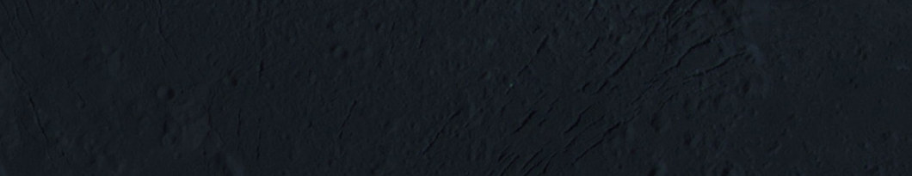
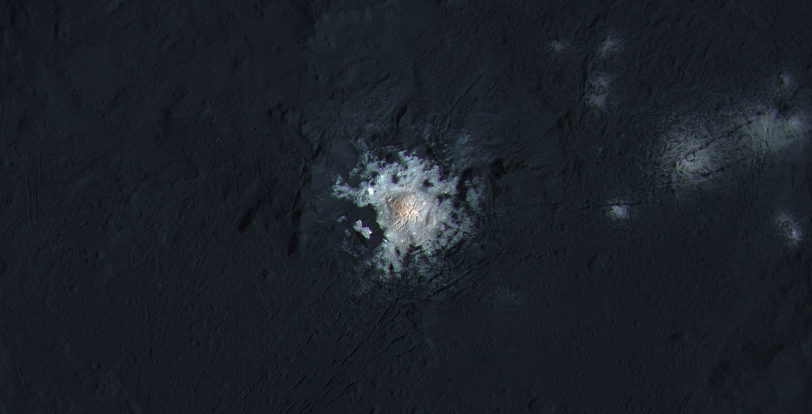

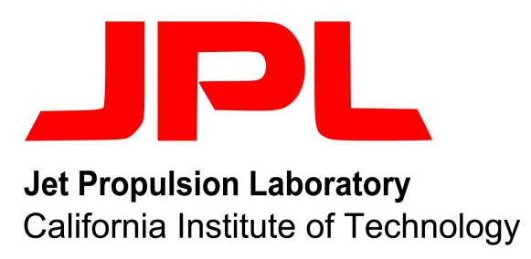
Laboratory Analysis of Ceres Analogue Minerals
Lucas Reynoso¹
Maitrayee Bose² and Julie Castillo-Rogez³
Arizona Space Grant Symposium
April 22nd, 2023
¹School for Engineering of Matter, Transport & Energy, Arizona State University; ²School of Earth and Space Exploration, Arizona State University; ³Jet Propulsion Laboratory, California Institute of Technology

Slide 2

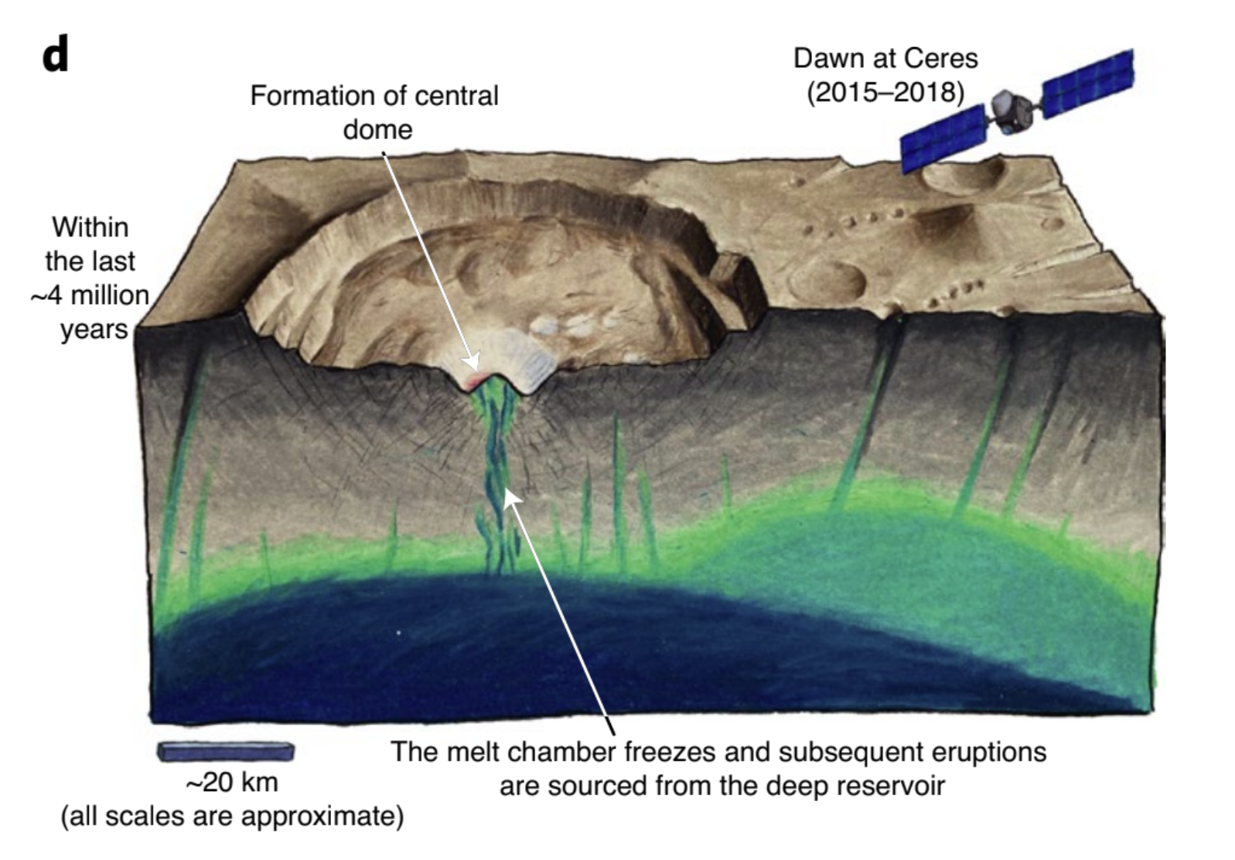
What are the bright spots on Ceres surface?
These bright spots were determined to be evaporate deposits containing minerals like sodium carbonate (Na₂CO₃), ammonium carbonate (CH₈N₂O₃), and hydrohalite (NaCl)
Source: NASA/JPL-Caltech/UCLA/MPS/DLR/IDA/PSI
Credit: J.T. Keane, NASA/JPL-Caltech
Notes:
We know there is an ocean on Ceres because of these bright, white spots on Ceres’ surface discovered by the Dawn mission back in 2015. These spots, which are shown in the image on the left, were determined to be evaporite deposits containing minerals like sodium carbonate, ammonium carbonate, and hydrohalite. These deposits are significant because they indicate the presence of subsurface water and potential geologic activity on Ceres. Scientists argue that impacts are hitting Ceres, creating fractures in the surface, and allowing this brine fluid to seep through the cracks. Once at the surface, the brines are flash-freezing and evaporating, leaving behind salts like you see imaged here. As these salts are forming from the brine-water mixture, they likely possess the same conditions ideal for forming complex organics. This is because they likely contain the three prerequisites for life: 1) the presence of water coming from the subsurface ocean, 2) a source of energy in the form of impact and radiogenic heating, and 3) and biocritical elements like carbon!

Slide 3
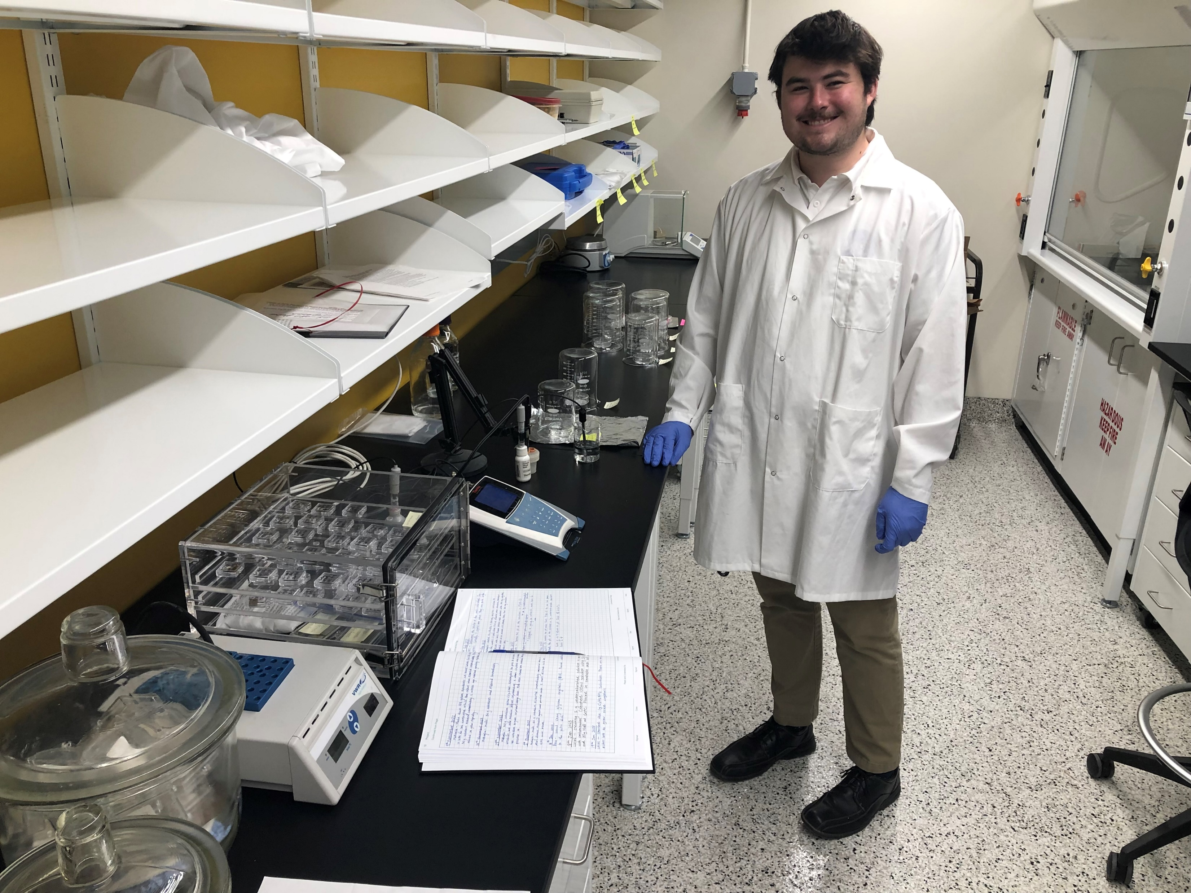

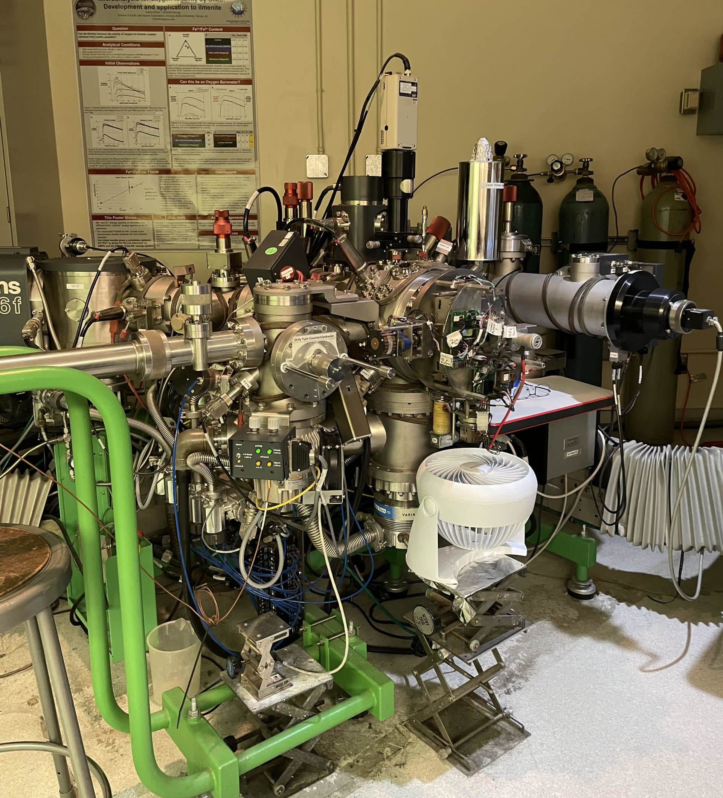
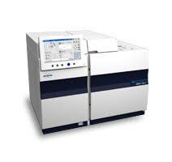
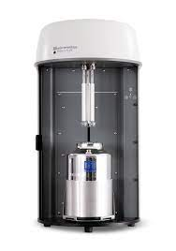
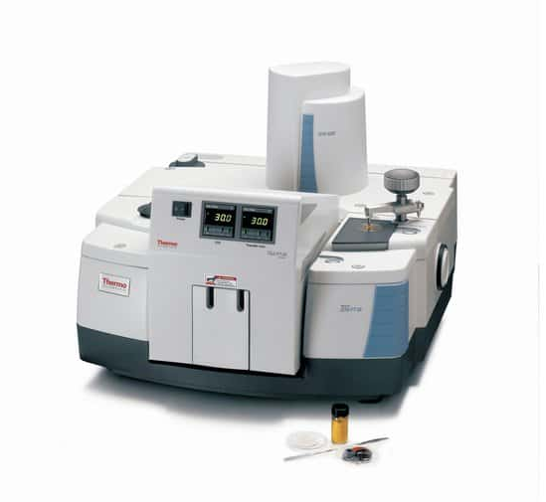
Experimental Roadmap
@ASU | @UA
Samples were synthesized
Perkin Elmer 2400 Elemental Analyzer
IMS 6F SIMS
Bruker Scion 456-Gas Chromotograpy
TriStar II Plus BET instrument
Nicolet iS50 FTIR Spectrometer
Notes:
This slide shows the various laboratory techniques, both at Arizona State University and the University of Arizona, used to characterize the salt crystals with glycine with specific science goals in mind. Our motive was to answer several questions regarding organic incorporation in salt materials and also to test the detection limits for these techniques.

Slide 4
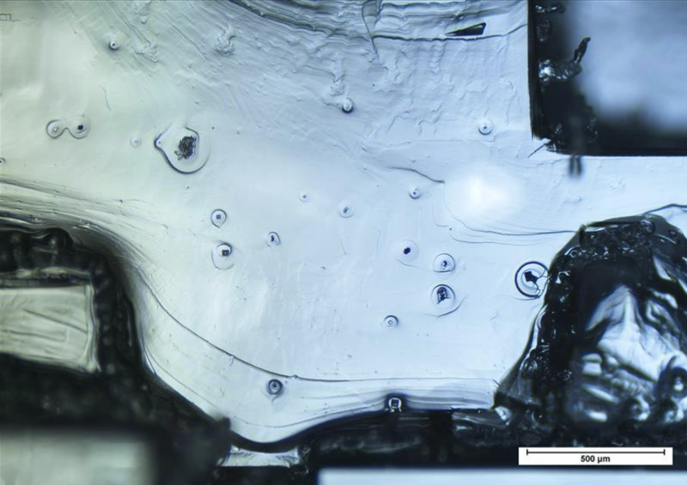
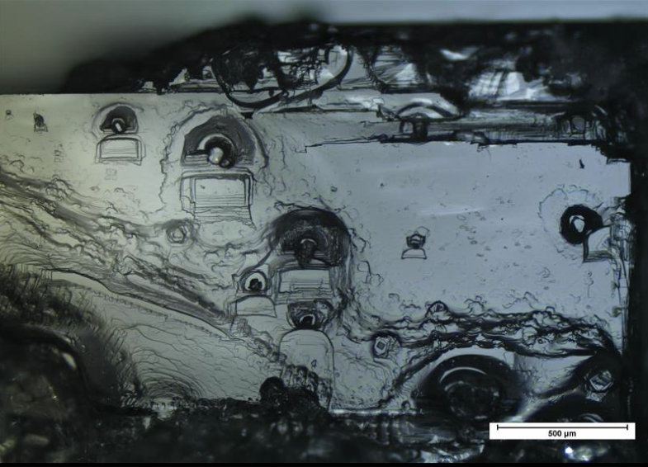
How does glycine change the physical properties of the salts?
blebs
blebs
500 µm
500 µm
500 µm
Pure NaCl
NaCl + 0.07 M Glycine
NaCl + 0.13 M Glycine
Notes:
One of the things we are aiming to understand is how the presence of glycine changes the physical properties of the salts. These are reflected images taken on an optical microscope of some of the samples I have grown.
On the left is a reflected light image of a pure NaCl crystal, which is predominantly white, and its growth layers are distinctly visible. Upon the addition of glycine, two features appear, as shown in the middle image. First, tiny, dark blebs emerge on the surface. Second, a darker hue is seen throughout the crystal, making it more opaque, showing that the presence of glycine changed the crystal’s optical properties. The rightmost figure shows a crystal with double that amount of glycine, and in this case, the crystal has become even darker, and larger blebs can be seen on the surface.

Slide 5
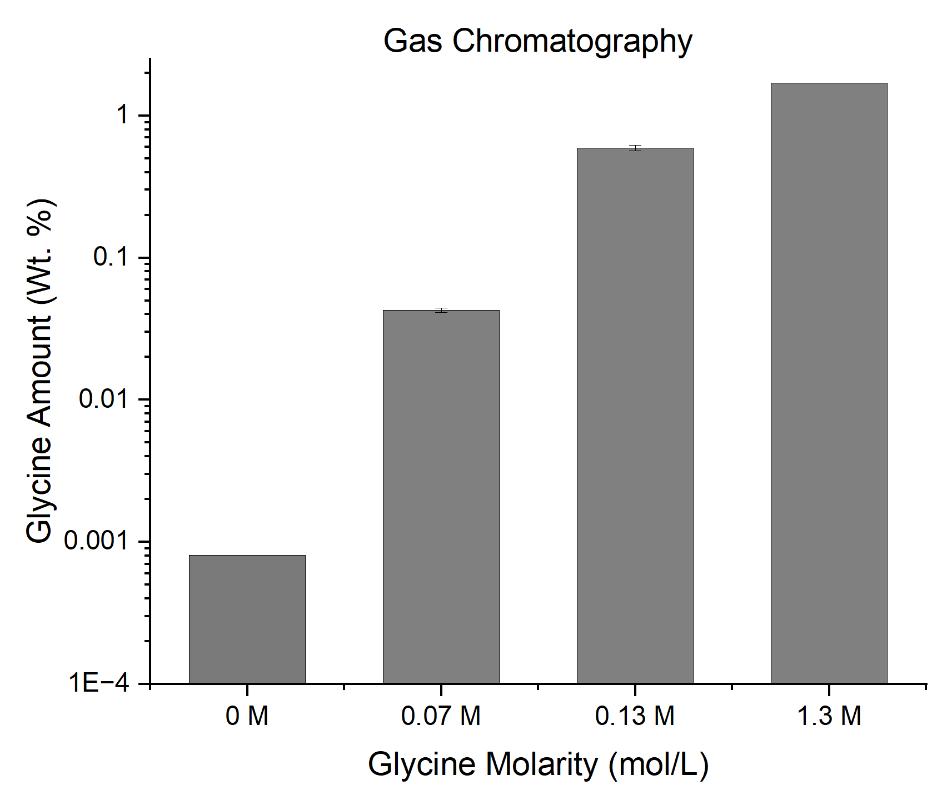
How much glycine is detectable within the samples?
Methods similar to Cao et al. 1997; Hušek 1991
Glycine abundance increases with increasing glycine concentration in the solution
The relationship, however, is disproportionate and nonlinear
Notes:
The results are displayed in the figure on the left, which shows the glycine amount in weight percent on the y-axis and glycine molarity on the x-axis. The result indicates that the glycine concentration and abundance have a nonlinear relationship. The glycine abundance increases with glycine concentration included in the original solution, but not proportionately. This gives us an empirical relationship to quantify the amount of glycine one would expect in salt, with very low abundances of glycine. With this technique, we are able to measure 2.5 ppm glycine.

Slide 6
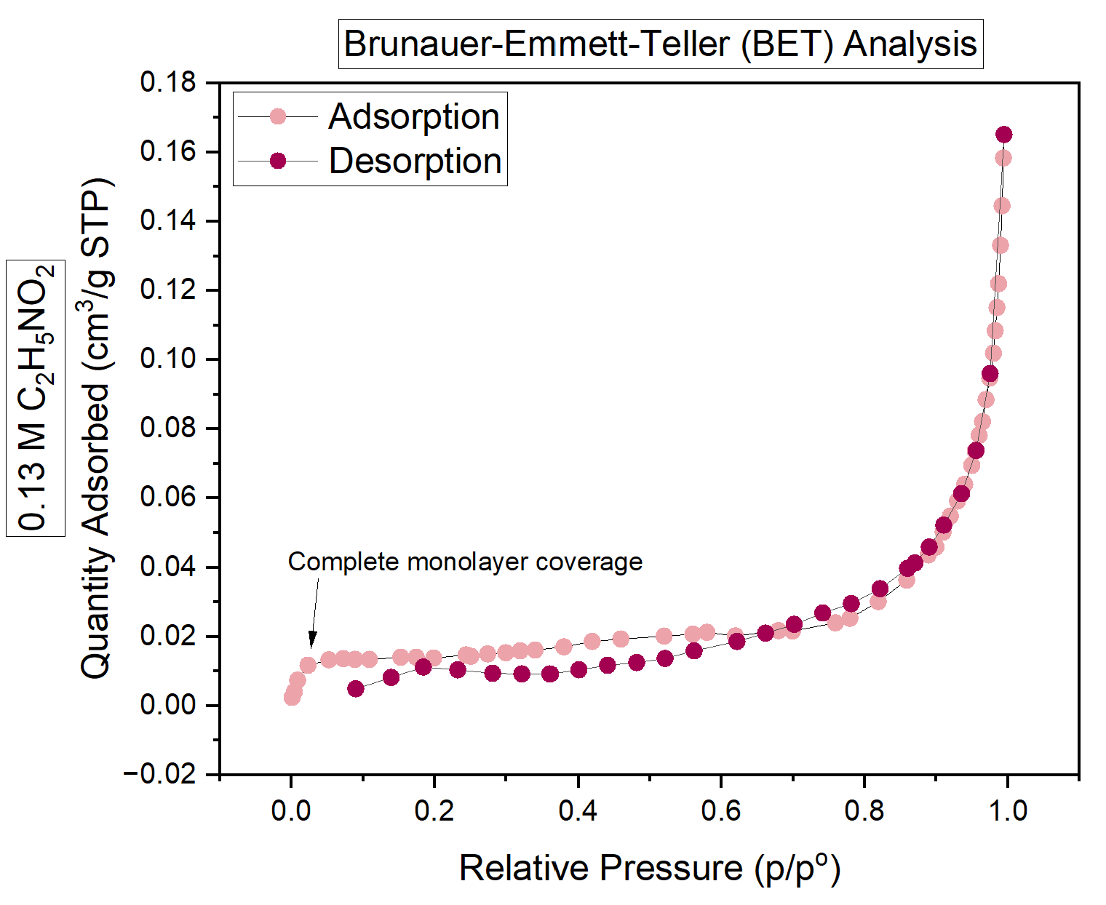
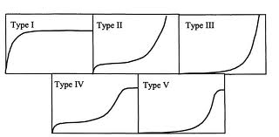
How does glycine impact NaCl porosity?
Exhibits Type II adsorption isotherm characteristics as the monolayer forms quickly, indicating the crystal surface is not microporous
Notes:
On the left, I am showing you a plot with the relative pressure and the quantity of nitrogen gas adsorbed and desorbed from the surface of a 0.13 M glycine crystal. As the pressure of the gas increases, we see a monolayer of nitrogen molecules get adsorbed onto the sample crystal surface quickly, followed by multi-layer adsorption at higher pressures. The monolayer represents the point at which the adsorption of gas molecules on the surface of a material reaches a maximum. This maximum corresponds to the formation of a single layer of gas molecules on the surface, where each molecule is attached to the surface by a single bond. Based on the adsorption and desorption curves, we are able to derive additional information about the crystal porosity and pore size distribution.

Slide 7
Correlating composition with porosity
Sample Name | 0.13 M NaCl | Pure NaCl
Average pore diameters | 16.7 nm | 12.4 nm
Calculated Porosities | 43.5 % | 39.3 %
Observed changes in pore sizes; porosity differences are small
First step: Correlate the chemical composition of brine solutions to porosity differences
Important as reflectance spectra show a decrease in reflectance with particle size Mustard and Hays 1996
Spectral features on porous surfaces are more detectable in the mid-IR range (~8 – 25 µm) Young et al. 2019
Notes:
The table shows the average pore diameters of the 0.13 M and glycine-free crystal. We can clearly see a difference in the pore size as the diameters have increased with increased glycine content. The calculated porosities are almost identical. Currently, we have only conducted this study for a test case and are planning on performing additional experiments to confirm this pore size distribution. These future experiments will also help us understand the errors associated with the porosity calculations.
We do know that porosity is an important metric as the reflectance spectra change with particle size. For example, decreasing particle size results in a systematic shift in the position of the maximum reflectance to shorter wavelengths, and a change in the symmetry of features. Additionally, porous surfaces are more detectable in the 8 to 25-micron range due to their higher emissivity.

Slide 8
Key Questions Answered
Is glycine incorporated into the growing NaCl crystals?
Yes!
How much glycine is detectable within the crystal?
Current detection limit is 2.5 ppm glycine
How does glycine impact NaCl crystal porosity?
Alters the pore size distribution; insignificant porosity changes
Lucas Reynoso | lrreynos@asu.edu | Arizona State University
Acknowledgments: Supported in part through the Arizona NASA Space Grant Consortium, Cooperative Agreement 80NSSC20M0041.

